Slide 1
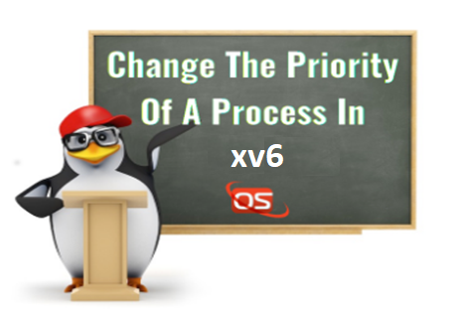

Operating Systems Design -19CS2106S
Skill Session- 07
Understanding Text Processing
xv6 : vm.c, umalloc.c
Priority scheduler in xv6
chpr

Slide 2
Understanding Text Processing : awk
With awk, you can process text files. awk assigns some variables for each data field found:
$0 for the whole line.
$1 for the first field.
$2 for the second field.
$n for the nth field.
The whitespace character like space or tab is the default separator between fields in awk.

Slide 3
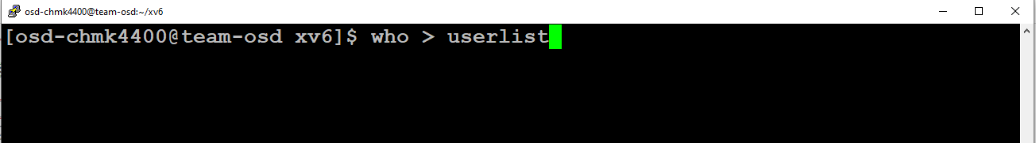
Understanding Text Processing :
Creating File for processing :
The standard Unix command who displays a list of users who are currently logged into the computer.
Output Redirection ( > ) : Out put of command we will store in userlist file

Slide 4
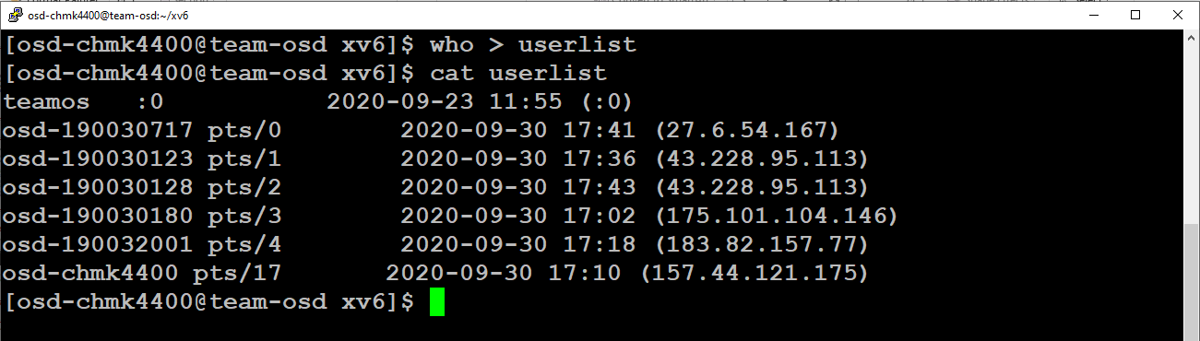
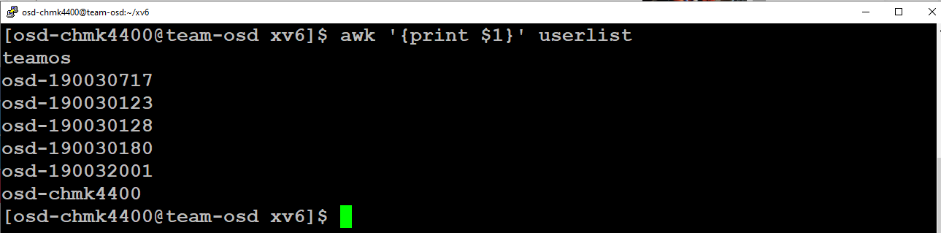
Understanding Text Processing :
Check this example and see how awk processes it:
The above example prints the first word of each line.

Slide 5
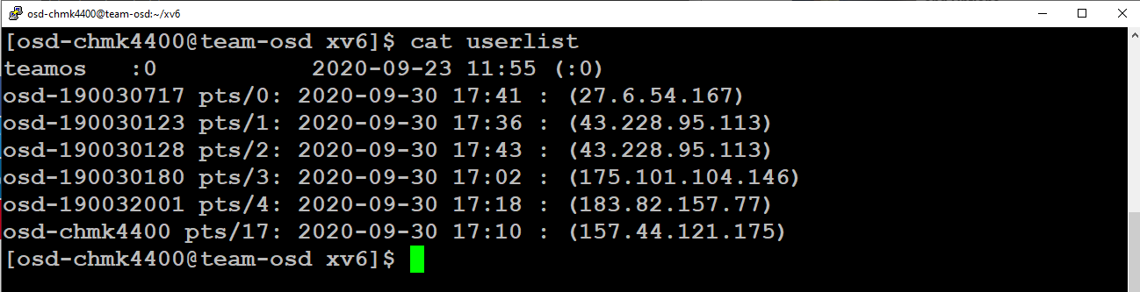
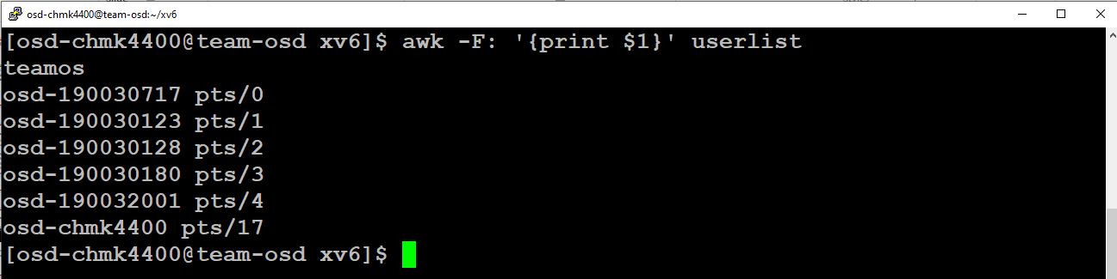
Understanding Text Processing :
Sometimes the separator in some files is not space nor tab but something else. You can specify it using –F option:
This command prints the first field in the userlist file. We use the colon as a separator because the userlist file uses it.

Slide 6
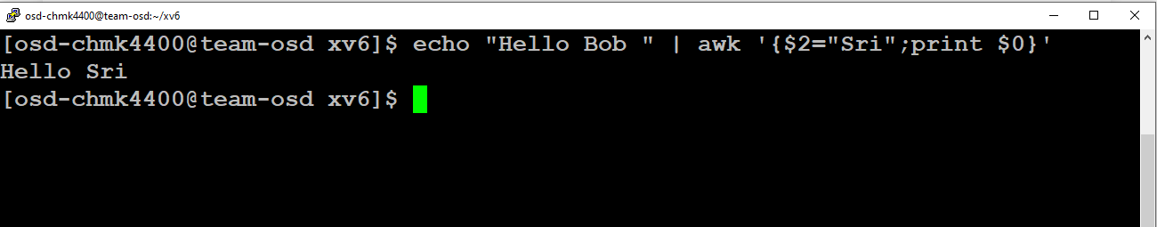
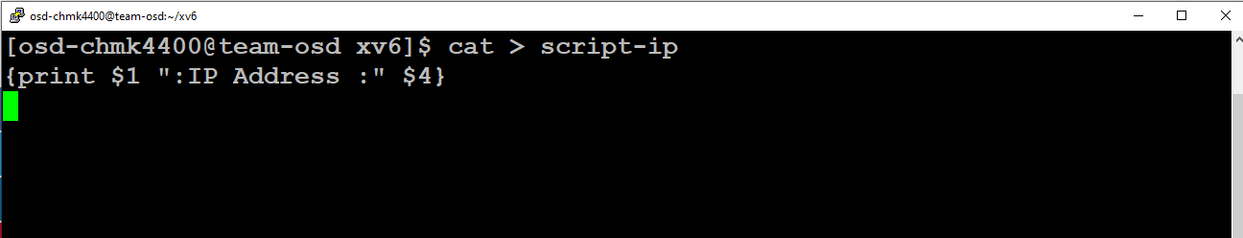
Understanding Text Processing :
Using Multiple Commands :
To run multiple commands, separate them with a semicolon like this.
Reading The Script From a File
You can type your awk script in a file and specify that file using the -f option.

Slide 7
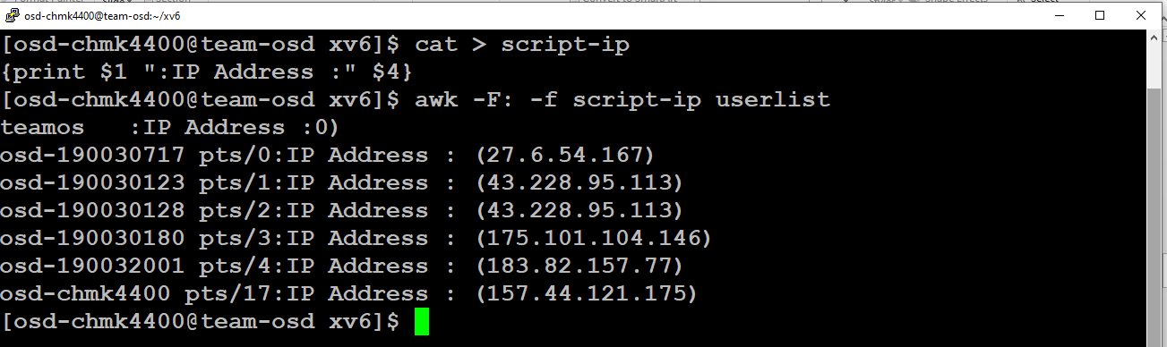
Understanding Text Processing :
Here we print the username and IP Address , and surely the separator is specified with capital -F which is the colon.

Slide 8
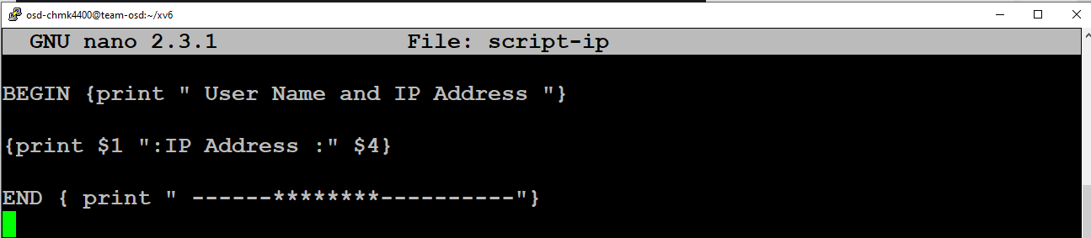
awk pre-processing : If you need to create a title or a header for your result or so. You can use the BEGIN keyword to achieve this. It runs before processing the data.
Understanding Text Processing :
awk post processing : To run a script after processing the data, use the END keyword.
This is useful,a header for your result and footer for example.

Slide 9
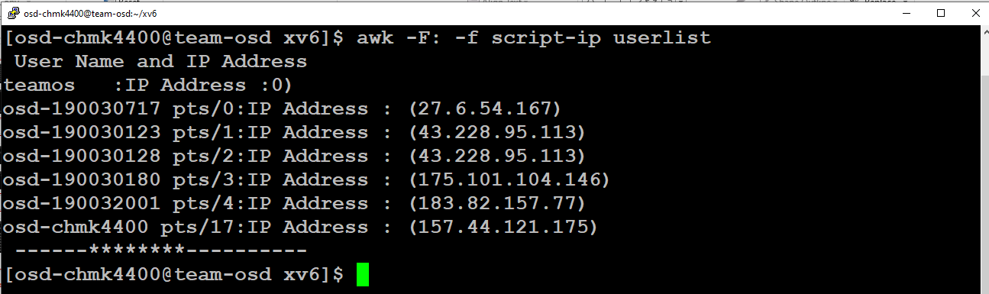

Slide 10
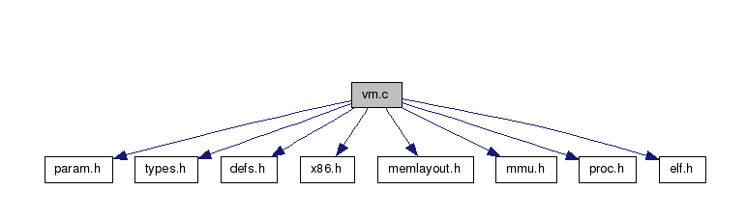
Dependency graph for vm.c:
xv6 : vm.c
Manage page tables and address spaces
Click on the links below to find out more
Reference : https://www.cse.iitd.ernet.in/~sbansal/os/previous_years/2013/xv6-html/vm_8c.html

Slide 11
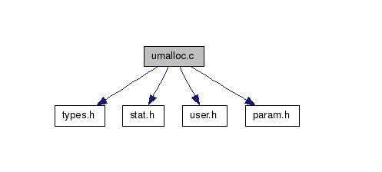
Dependency graph for umalloc.c:
xv6 : umalloc.c
user mode standard library
Click on the links below to find out more
Reference : https://www.cse.iitd.ernet.in/~sbansal/os/previous_years/2013/xv6-html/umalloc_8c.html#a94267ee40e0547410676894ab3f23c15

Slide 12
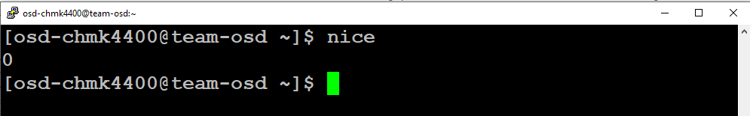
Nice Command In Linux
With the help of Nice command in Linux you can set process priority. If you give a process a higher priority, then Kernel will allocate more cpu time to that process.
By default when a programe is launched in Linux, it gets launched with the priority of '0'. However you can change the priority of your programes by either of the following methods.
1. You can launch a programe with your required priority.
2. Or you can also change the priority of an already running process.

Slide 13
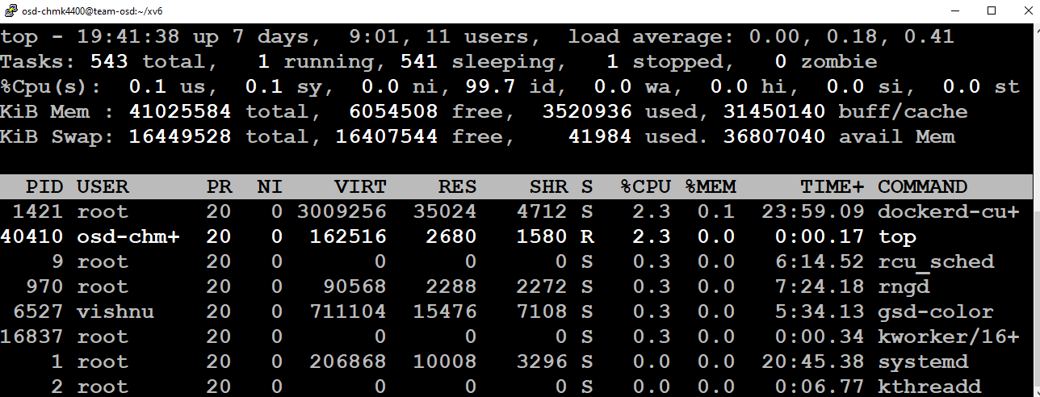
Checking the Priority of Running Processes :
The easiest way to get a quick picture of what the current niceness priority on a process is to open up the top processes with: top

Slide 14
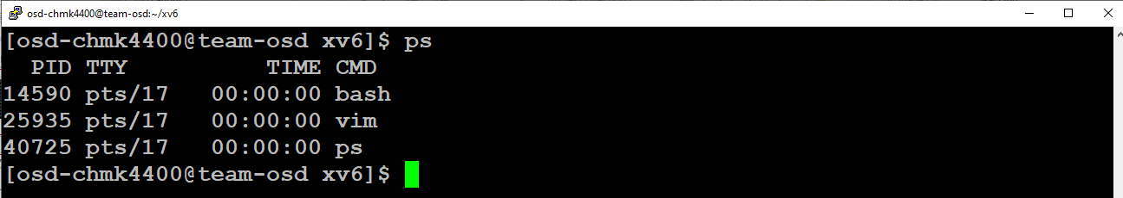
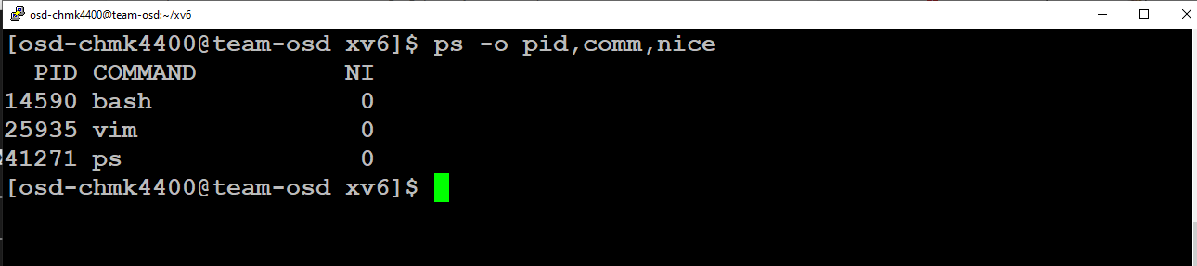
Another way you can get the nice value is use ps
By default when a program is launched in Linux, it gets launched with the priority of '0'.

Slide 15
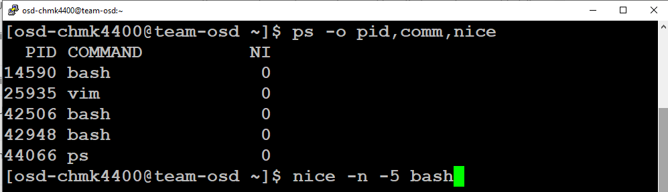
Now start a bash shell with nice value -5
The Linux niceness scale goes from -20 to 19. The lower the number the more priority that task gets. If the niceness value is high number like 19 the task will be set to the lowest priority and the CPU will process it whenever it gets a chance. The default nice value is zero.

Slide 16
xv6 -Implementing ps, nice system calls and priority scheduling
The default algorithm implemented in xv6 it's one of the simplest (with FCFS) and relies on the Round-Robin policy, basically it loops through all the process which are available to run (market with the RUNNABLE ) state and give access to CPU at each one of them one at a time.
Scheduling in xv6 :
In this scheduling policy the scheduler will select a process from a lower queue only if no process is ready to run at a higher queue. The algorithm first runs all the process with highest priority and then, when they finish, it will consider all the process with a lower priority..

Slide 17
Xv6- Implementing ps, nice system calls and priority scheduling :
syscall.h
proc.h
defs.h
user.h
sysproc.c
usys.S
syscall.c
ps.c
nice.c
proc.c
exec.c
dpro.c
Makefile
→ create/update the above files in xv6 source code.
→ For more details follow reference document skill 7.

Slide 18


